Slide 1
Pollen for pollinators
Capstone proposal
Nancy Parmalee, Ph.d.
Fellow candidate – summer 2021

Slide 2
The problem
Pollinator species are in decline worldwide
Our food supply and the integrity of ecosystems depends on pollinators
Colony collapse disorder (CCD) struck honey bees hard in 2006 with major colony losses.
Losses have slowed as beekeepers learn to manage symptoms – so there is hope!
Part of the solution is providing pollen and nectar sources, and everyone can help!
The USDA catalogs over 250 species of pollinators and the crops on which they depend, including Monarch butterflies, other butterfly species, moths, bats, and other insects.
Great! I would like to help! What should I plant and when?

Slide 3
The problem
Pollinators including honey bees need pollen and nectar sources that are available throughout their lifecycle.
One example of a problem: the hard freeze in Texas in February 2021 killed or delayed flowering of many species that pollinators depend on.
There are vast troves of data on plants for pollinators in university extensions such as Texas A&M University and from the US Department of Agriculture (USDA).
The data is scattered and there is not a data driven answer to the question “What should I plant and when?”

Slide 4
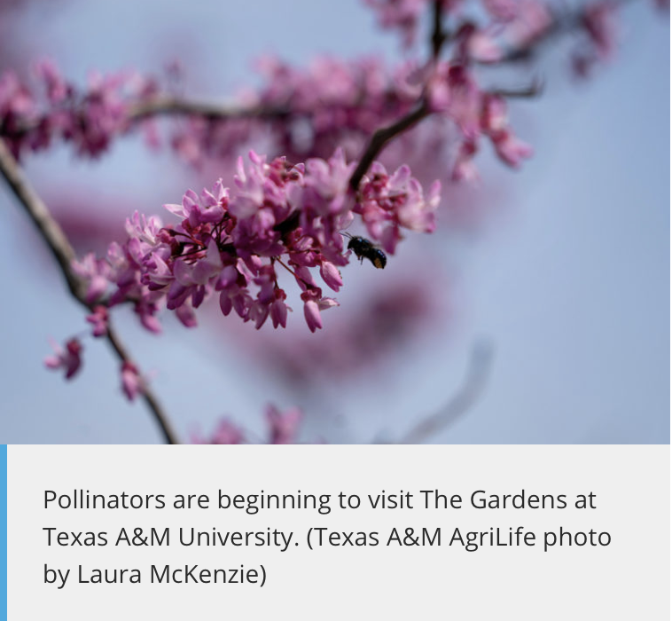
“I may even make a spreadsheet and make my columns with the month of year and annotate these plants according to when they bloom to ensure I have things covering all the months needed for adequate pollinator support.”
- Michael Arnold, Ph.D., director of The Gardens at Texas A&M University and professor of landscape horticulture for the College of Agriculture and Life Sciences

Slide 5
The solution
There is an adage that says “beekeeping is local.”
I can compile public data from university extensions, the USDA, and web scraping to provide a local, data driven answer to the question “What should I plant and when, and for which pollinator species?”

Slide 6
The deliverable
A website that would ideally evolve into an app to provide needed information to plant for pollinators – anyone with space from a small balcony to a large farm can use this to support pollinator species!
What information would it provide?
Plant species for the pollinator of your choice – “I want to support Monarchs, what should I plant?
Plant requirements: hardiness zone, sun, shade, water requirements, soil type
Native plants
Growth habits of plants – “What will fit into my garden?”

Slide 7
The roadmap
Compile public datasets from university extensions, USDA, and webscraping of sites such as The Ladybird Johnson Wildflower Center at wildflower.org and many others
Harmonize the data into a new, rich dataset
Develop queries to provide a gardener with local, seasonal information that is actionable to answer specific questions such as “It is May, I am in zip code 75208, I have a sunny spot, what can I plant now for honey bees?”
The mature app will return images of plants
Push notifications will respond to alerts set such as “Tell me when it is time to plant something blue in my town for honey bees.”

Slide 8
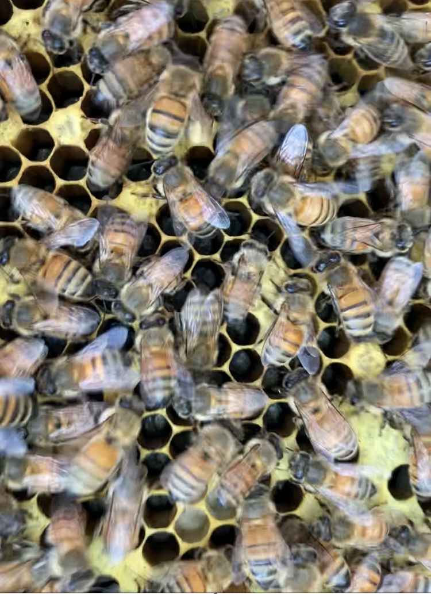
These are MY bees!
The bees and I thank you for your consideration.
Please plant where you can to support the bees and other pollinators! We depend on them!

